Slide 1
How consultation and community benefits should be used to build local support for development projects
February 2026

Slide 2
Infrastructure as a key cause of concern over development

Slide 3
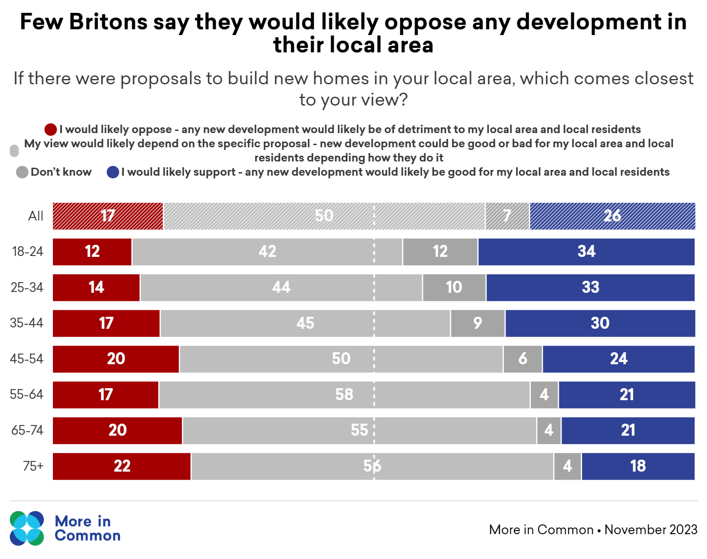
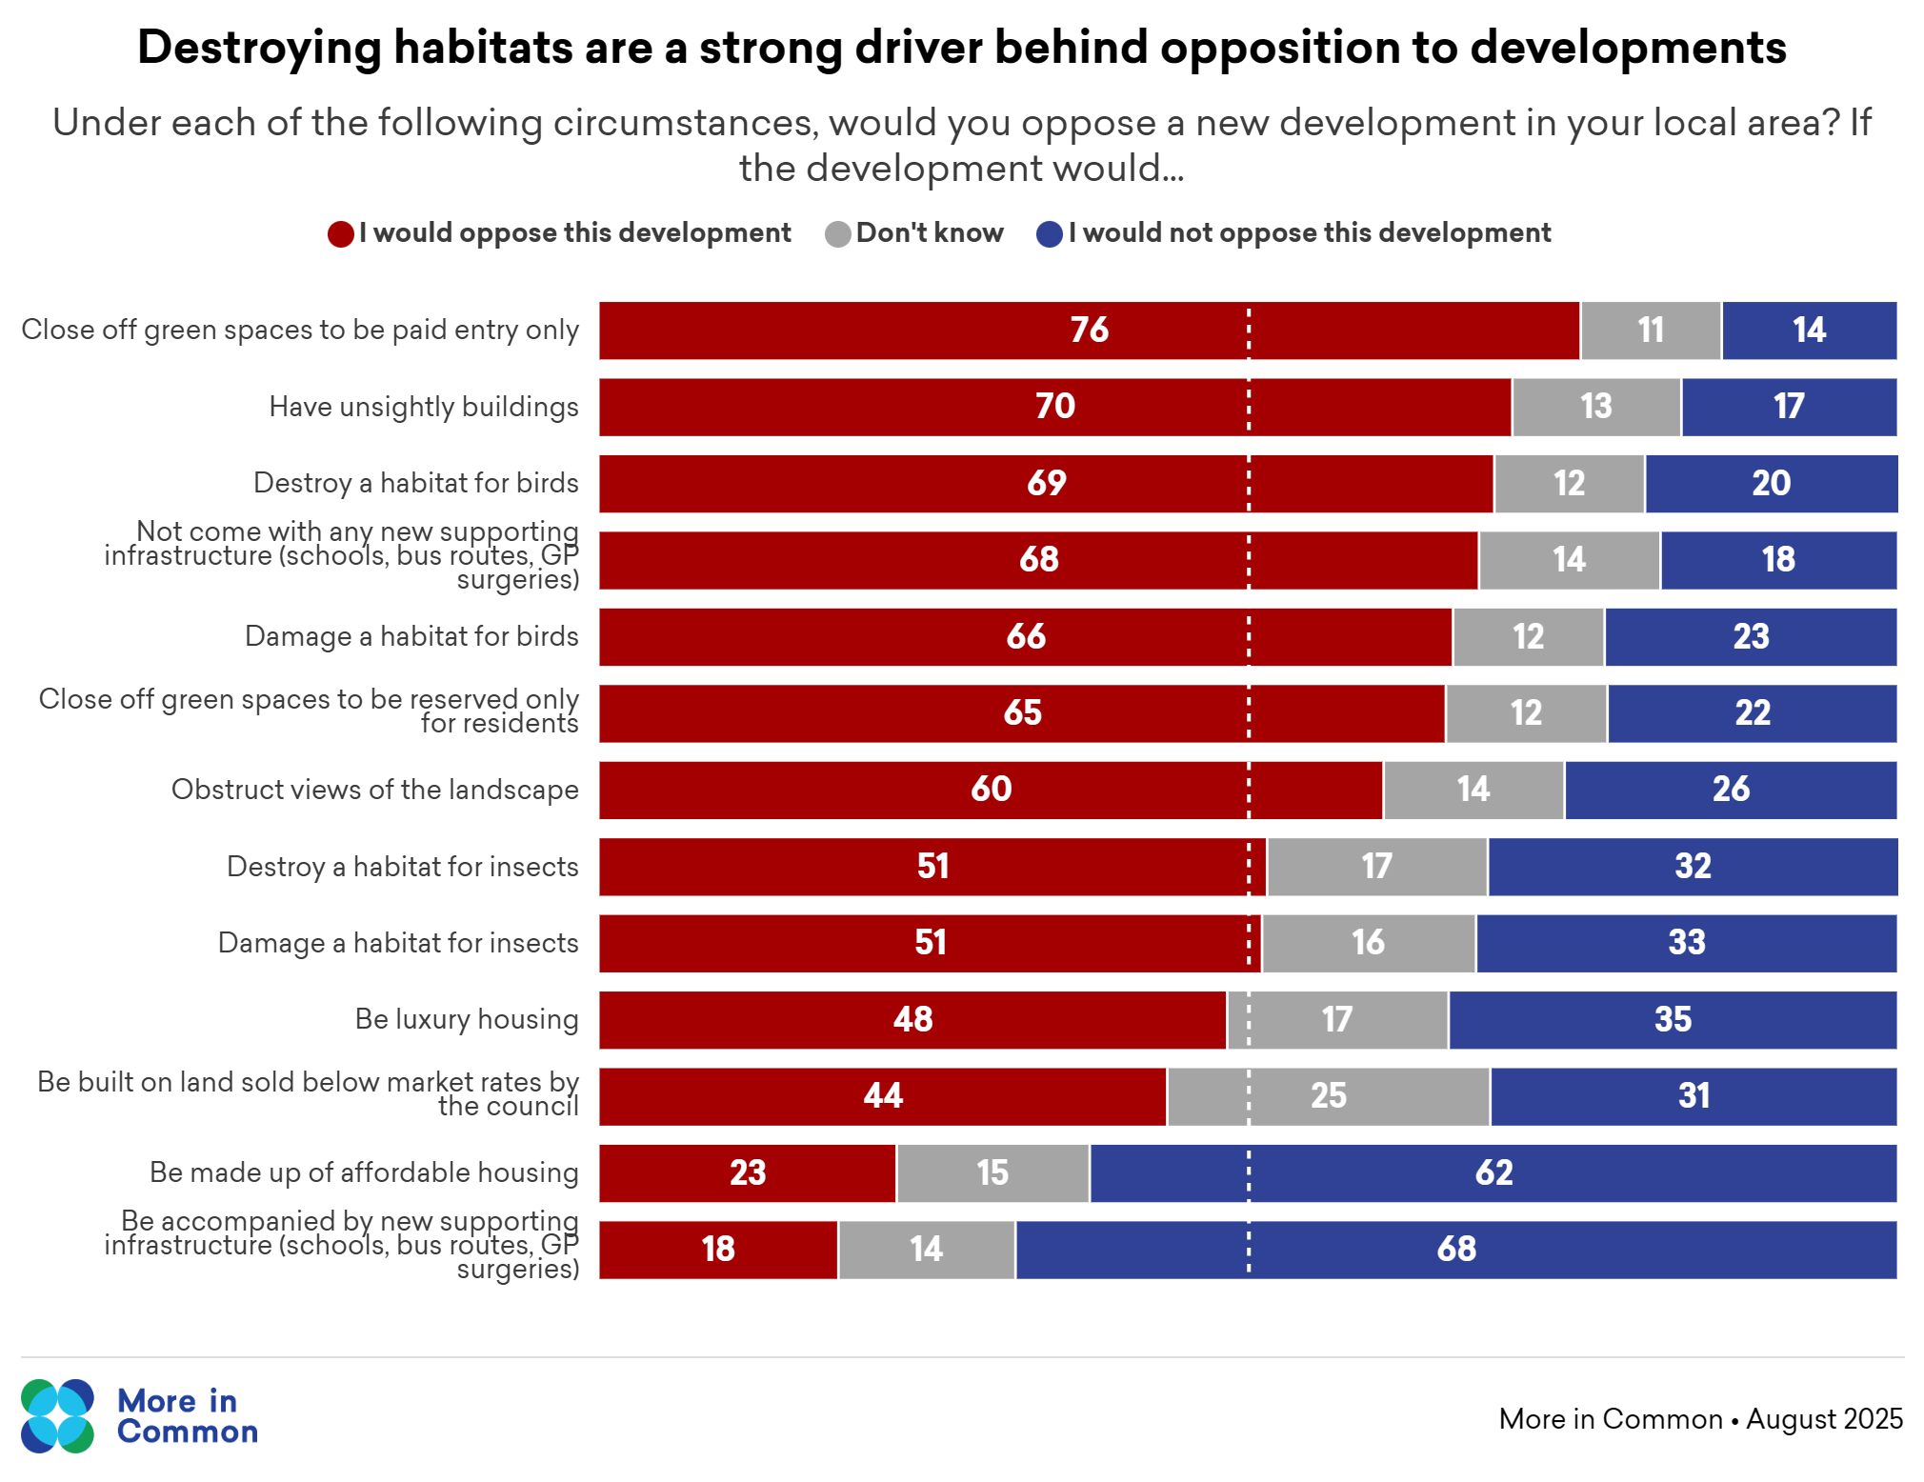
Britons have their gripes with new developments, but they do not necessarily mean they will oppose them
Generally, only 17 per cent of the public say they would likely oppose new developments in their local area but a failure to provide adequate supporting infrastructure is the biggest driver of opposition.

Slide 4
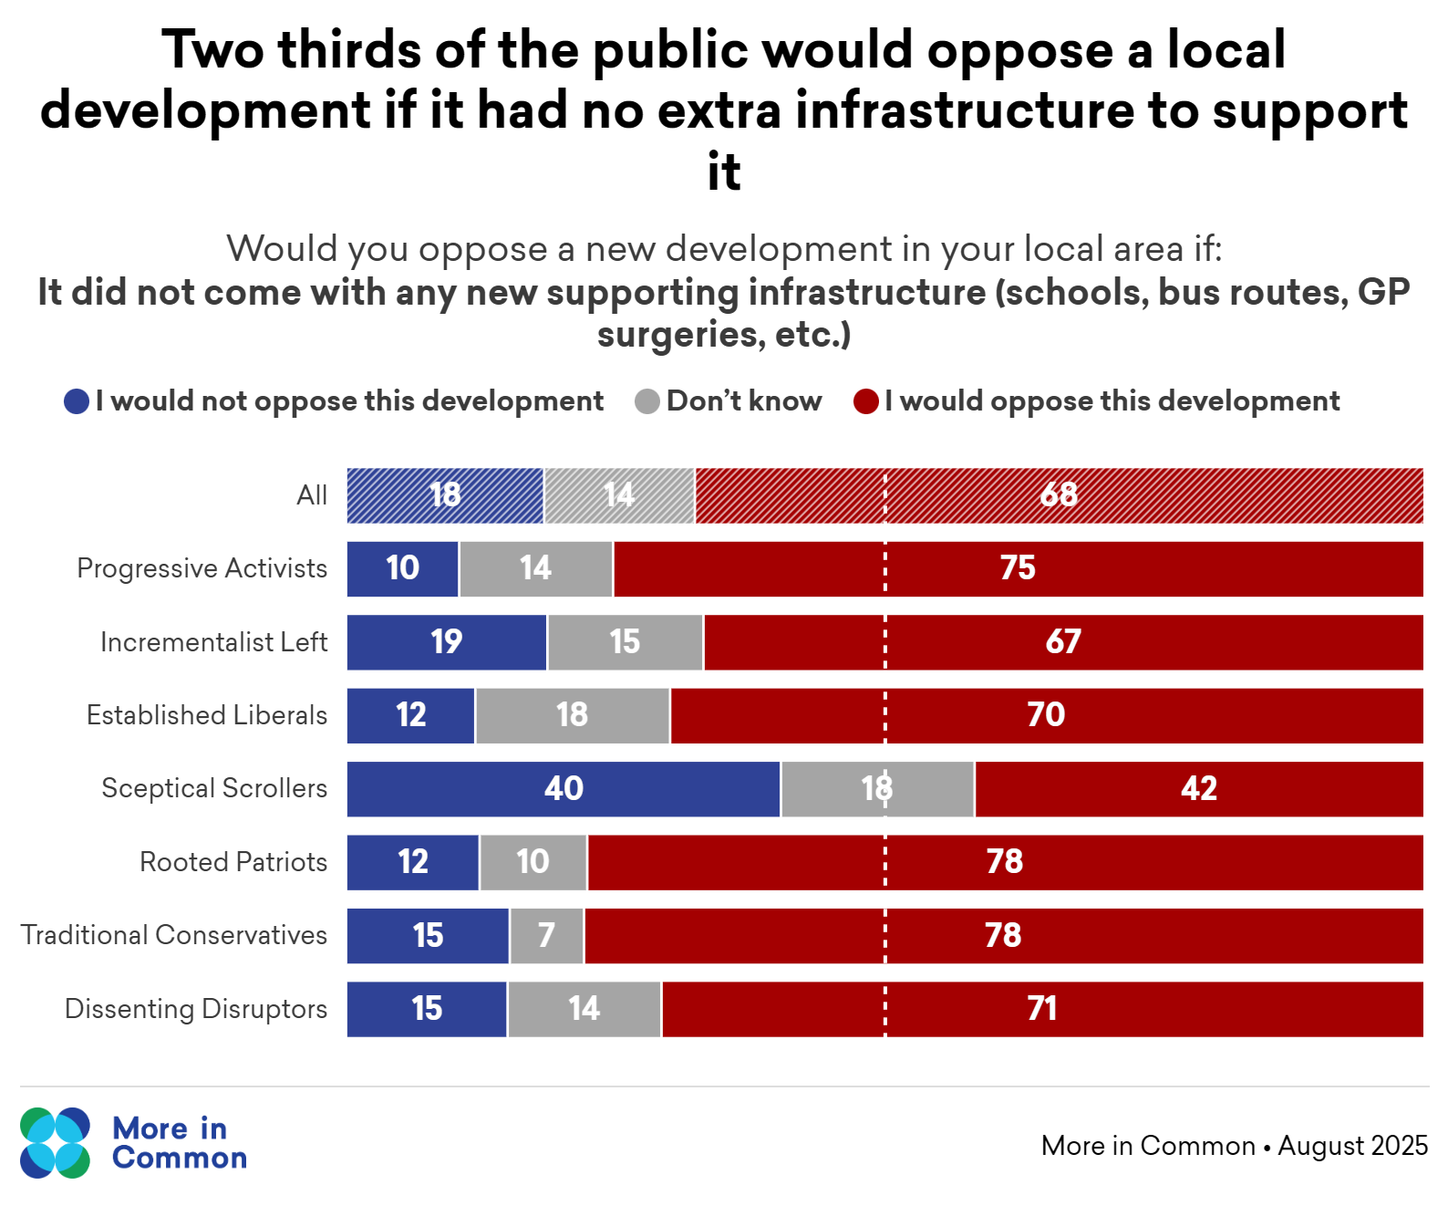
Lack of infrastructure drives opposition to developments
Britons have worries about how new developments could put strain on local services which are already under pressure.
Reassurance that developments will come with more investment in local infrastructure will go a long way to assuaging these concerns.
“We need more housing. The population's growing… [But] I think people buck against it because they think, well, where are the doctor surgeries? Where's the extra capacity in the hospital? Where are the schools? The roads are busier and busier but yet they haven't fixed potholes and there's traffic everywhere. I just think if there was any attempt to do it smoothly and intelligently… it seems they never take that opportunity in my opinion, ever.”
Fiona, Personal Assistant, Basingstoke

Slide 5
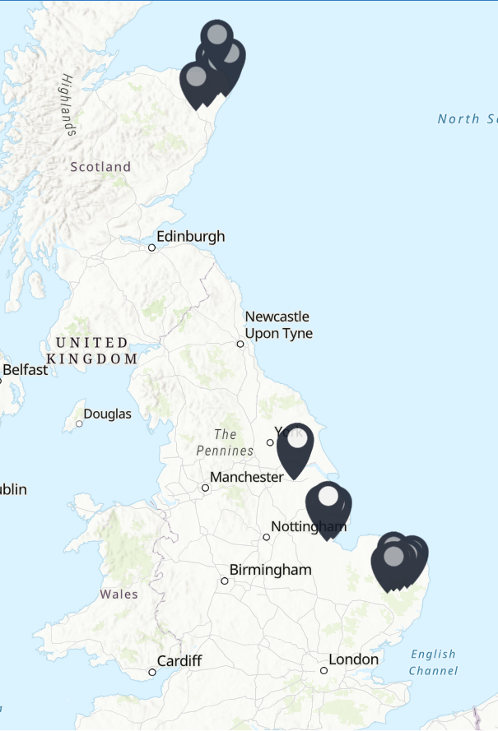
Attitudes towards grid infrastructure

Slide 6
Project overview
With opposition to planned energy grid infrastructure along the East Coast strong, More in Common partnered with Local Storytelling Exchange as part of their deliberative research project exploring how consultation and community benefits should be designed to build as much buy in as possible from local communities.
As part of this, More in Common recruited four focus groups in the communities most affected by the construction of pylons. The groups were held in early 2025 and so our previous segmentation model formed the basis of our recruitment criteria.
The focus groups explored headline attitudes towards the grid infrastructure, trust in the consultation process and the role that community benefits can play in building support.
The writeup of the wider report is available on Sustainability First’s website here.

Slide 7
The focus group locations and rationale
Group One, Aberdeenshire - Backbone Conservatives
One of the most rural areas in the country, selected to understand the views of voters in the Conservatives’ traditional shire seats and to assess how attitudes vary in Scotland.
Group Two, Waveney Valley - Established Liberals
A seat symbolic of the Conservatives’ Southern England ‘Blue Wall’ captured by Green Party. Selected to assess attitudes in the Blue Wall and in a location where anti-pylon campaigning has perhaps been most vociferous.
Group Three, Boston – Disengaged Traditionalists
The most Leave-voting area of the country, this area also experiences significant deprivation with the lowest share of university graduates in the UK.
Group Four, Scunthorpe – Loyal Nationals
An archetypal Red Wall constituency with local circumstances (the impact of high energy prices on British Steel) symbolic of the opportunities investment in renewable energy infrastructure presents. Selected to assess how attitudes vary in the Red Wall and in urban areas affected by grid infrastructure plans.
These focus groups took place across March and April last year.

Slide 8
Key research findings
Opposition to grid infrastructure is strong among those who live nearest. This opposition is being driven by a feeling that while they must deal with the negative impacts of the infrastructure, mainly the impact on local visual landscapes, those in other parts of the country will be the ones enjoying the benefits.
There is not a cross-place consensus on the optimal form of community benefits and there is little confidence in government and the grid companies to deliver the types of benefits that local communities actually want.
There is minimal confidence that those participating in the consultation process will genuinely have their views heard and this, rather than disinterest, is driving limited willingness to engage with consultations.
In the most part, attitudes and consideration of grid infrastructure are being driven by local-specific circumstances rather than core values so trying to build predictions of individuals’ views at the regional, or even segment level, is challenging.

Slide 9
The overriding feeling was one of opposition to the grid infrastructure
Across all four focus groups, there was a sense of strong opposition to grid infrastructure plans for their local areas.
This opposition felt emotional for many participants who were frustrated and annoyed.
Our participants were also resigned to the development of the grid infrastructure going ahead despite local opposition.
The negative impacts are 65 high metre pylons being put in literally less than half a mile away which will completely spoil our view. We are getting nothing from this.
Dave, Backbone Conservative, Aberdeenshire
I think that we won't have a choice and the decision will be made and they will be put up.
Linda, Established Liberal ,Waveney Valley

Slide 10
Concerns over visual landscape the key rather than the environment
The perceived negative impact on visual landscapes was driving our participants’ concerns – even if they used environmental terms to describe this opposition.
The only exception to this was in Boston where concern about the potential impact on local bird populations was more significant.
It'll spoil the beauty of the area... we've got such great views around here.
Kylie, Disengaged Traditionalist, Boston
Once those pylons are up, those scars, they’re going to be there forever
Jason, Established Liberal, Waveney Valley
We've got all sorts of large birds of prey that we haven't seen in years that are finally recovering in our area just as they're planning to set up traps called pylons
Daniel S, Disengaged Traditionalist, Boston

Slide 11
Concerns over fairness are driving this opposition
A strong sense that the grid plans are unfair to these local communities is driving opposition:
They feel their communities are being blighted with the negative impact of infrastructure but those in Southern England will be the only ones to reap the benefits as the consumers of the electricity.
In Scunthorpe and Boston they thought those in power believed their area was sufficiently run down that they didn’t need to worry about protecting it.
They thought the pylons were only being built overground because that would maximise profits for the energy companies – there was no recognition this would reduce costs and customer bills.
All the energy from the pylons that’s coming from out west is getting fed to the North of England. All of it. We get nothing from this.
Dave, Backbone Conservative, Aberdeenshire
Everything will be above ground as it’s cheaper, but the main beneficiaries would be people down south who will get to keep their nice pristine countryside. We've got all the pylons and by the time it gets down south, somebody will have found the money to start burying the cables. So again, we're just treated as a northern industrial dumping ground for all the rubbish bits.
Nigel, Loyal National, Scunthorpe
I think there’s no economic benefit [from the pylons]. The economic benefits comes from the fact that it is going to be cheaper for them to install and it’s as simple as that, it’s just more profit.
Jason, Established Liberal, Waveney Valley

Slide 12
Attitudes towards community benefits

Slide 13
Discussion of community benefits raises accusations of “bribery”
Introducing the concept of community benefits in the context of pylons generated a strong initial backlash with several describing the idea as a form of “bribery”.
Ensuring that community benefits aren’t seen as an attempt to buy off local opposition to pylon plans will be key.
It just sounds like a massive bribe. You might as well have said they’re going to give everyone a bribe to put them up because that’s how it sounds to me.
Phil, Established Liberal, Waveney Valley
You call it community benefit, I call it a bribe.
Roy, Disengaged Traditionalist, Boston
I’ve got a bit of a problem with it, because it just feels like, let’s throw’em a bone, give them a bit of cash and then we can do what we want.
Miriam, Loyal National, Scunthorpe

Slide 14
But local residents take a transactional approach
Despite viewing community benefits as a form of bribery, our participants welcomed the idea.
Their approach was highly transactional. They thought that if something bad was happening to their local area they deserved something good in return.
Though it is unlikely to convert opposition into support – successfully delivered community benefits could help weaken opposition by reducing feelings that local communities are getting a raw deal.
I think I would find that if it benefited the community and jobs and stuff, it would make it a bit easier
Donna, Backbone Conservative, Aberdeenshire
I think if it's taken something away from the community like green spaces or parks or something else, then it should be replaced and replicated somewhere else
Steve, Loyal National, Scunthorpe
If it’s going to happen anyway, I might as well get something out of it.
Michaela, Disengaged Traditionalist, Boston

Slide 15
Offer of bill discounts could backfire
Though they welcomed the concept of bill discounts for those near pylons - the specifics of the government’s proposal provoked an angry response.
Individuals thought that the offer of a £250 discount per year for 10 years was offensive as the impact of the pylons was far greater than this - both on property values and individuals’ wellbeing.
The perceived unfairness of the eligibility and generosity of the benefits means they would likely do little to generate goodwill among our participants, particularly for those who miss out on them.
What an absolute cheek… The amount of money they’re going to make and they’re going to pay £250 a year for someone that’s been so disrupted when they have their billions and billions of pounds, we’re going to get a measly £250 – it’s shocking.
Donna, Backbone Conservative, Aberdeenshire

Slide 16
A general desire for broader beneficiaries
Throughout the groups there was a recognition there was a need to target support at those most affected by the pylons - those living closest to the sites.
There was a consensus that the government’s 500m radius for bill discounts is too narrow and would exclude too many people who would be severely impacted by the pylons.
There was also a recognition that the funds available for community benefits and compensation would be too small to materially compensate every individual impacted by them - this led our participants away from bill discounts and towards shared community assets that they all could benefit from.
Maybe they’d have to be levels of compensation so the people within 500m get something and those in the wider area get a lesser amount off their bills so it’s gradated.
Rachel, Established Liberal, Waveney Valley
It should be spread out more evenly because it’s going to affect the community - everybody is going to be at a disadvantage.
Josh, Disengaged Traditionalist, Boston

Slide 17
Lack of faith in government provokes strong desire for local community-led allocation of benefits
Participants lacked confidence in their council’s ability to handle community benefit schemes.
They suggested the council would waste the money on pet projects and through incompetency and questioned whether they would ever see any of the benefits they were promised come to fruition.
This led to calls for the allocation of community benefits to be decided at a localised level so that local residents’ interests and preferences could be properly accounted for - some even suggested a local referendum.
I have no doubt about where it will go, it will be spent on what they [the local council] want to spend it on, projects that the local council have in mind rather than what the local people would like to see it spent on.
Kylie, Disengaged Traditionalist, Boston
If we leave it to the government, we’ll get something that’s no use to a man nor beast… so it has to be down to the people in the area to make the decisions.
Simon, Loyal National, Scunthorpe

Slide 18
Key recommendations
No-one-size-fits all: Our participants reached different conclusions of the ideal system of community benefits in all four focus groups. There is no one approach to community benefits that will work in all parts of the country – the operation of community benefits must be tailored to the local circumstances with meaningful community engagement to shape the form this takes.
Early timing is key: There was a common impression across all four groups that community benefits were just a bribe to quell opposition. Ensuring that community bribes are presented from the very start of the development process as being in conjunction with grid proposals rather than something that is seen to emerge only in response to and after local opposition, will be key for positioning them as compensation, not a bribe.
Design the benefits in a way that mitigates against low trust: Our conversation revealed a significant lack of public trust in government and grid developers to actually deliver the community benefits they promised. Ensuring community benefit proposals are clear and specific and frontloaded to kick in as quickly as possible will be helpful for addressing this scepticism. There was also great scepticism over the ability of government, including at the local level, to understand local community needs and allocate the community benefits to the right schemes. Ensuring that the local community has a chance to feed into the precise schemes opted for will be important for overcoming this lack of trust.
Fairness rather than mitigation the key: With the exception of our Boston group, there was little sense that community benefits must address the direct, environmental impact of grid infrastructure. Instead, a transactional and fairness based approach based on a belief that local communities are owed something good in return for being wronged was more dominant. Consequently, there isn’t neccesarily a need to ensure community benefits actually address the environmental problems created by the grid infrastructure development. Don’t be afraid of providing community benefits that provide local residents a good, like improved bus services, that has nothing to do with the impact of the infrastructure.

Slide 19
Attitudes towards the consultation process

Slide 20
Apathy towards engaging with consultations
Despite many of the participants having strong views on the pylon proposals, there was limited appetite among them to engage with the formal consultation.
Most of the participants hadn’t personally engaged with a consultation process before.
Despite this lack of personal participation, there was a strong sense that it was important for energy companies and local councils to consult local people.
Yeah, it’s definitely important for them to consult, a hundred percent because if it's going through our area then local people should have their views brought into account whether it'll change it if or not, it's a different matter. But yeah, just out of politeness or just out of regard, you should be consulted
Josh, Disengaged Traditionalist, Boston [Has never engaged with a consultation]

Slide 21
Consultations seen as having no impact on outcomes
The key driver of this apathy towards consultations was a feeling that they were ‘PR’ and window-dressing exercises rather than genuine efforts to canvass and incorporate feedback into the design process.
Participants across our groups, but particularly in Scunthorpe and Boston, thought there was no point participating in them as the outcomes were pre-determined as government and energy companies would do what they had always wanted to do.
Phrases like “tick box exercise” and “window dressing” were repeatedly used.
I've got to admit, I feel rather cynical about the process. If somebody has decided for whatever reason that they will benefit from the process, then it will go ahead regardless of any local objections... I always have the feeling that people at the bottom end will get steamrolled
Nigel, Loyal National, Scunthorpe
It just feels like it’s just ticking the box. We’ve done a consultation, we’ve let the people have their say and we’re going to do what we want anyway.
Roy, Disengaged Traditionalist, Boston

Slide 22
Previous bad experiences driving reluctance to engage with formal consultation processes
Negative previous experiences of consultations have shaped this poor perception.
Several of our participants spoke of submitting responses to past consultations and seeing no demonstrable changes to proposals because of it.
More broadly, HS2 was cited as an example of the government proceeding with large infrastructure projects without listening to local points of opposition.
Across all four focus groups the participants only saw a consultation as valuable if the responses shaped the final outcome - putting little value on the sole act of holding a consultation. For example, one of the few positive consultation experiences referenced was in Waveney Valley where the Council listened to respondents and reduced car park charges.
HS2 was consulted on at great length and where did they put the track exactly? Where they wanted to put it in the first place! They went through beautiful areas. They bought land by compulsory purchase order. So all the consultation, they might as well have saved their breath
Roy, Disengaged Traditionalist, Boston
With the meetings I’ve been to, it feels pointless sometimes to be fair. Quite a few people will voice the same opinion and it will still just go ahead anyway.
Donna, Backbone Conservative, Aberdeenshire
I think just things from the past that have happened that’s given me that impression that that’s all cut and dried before the consultation. I may be wrong, but that’s just how I feel.
Teresa, Established Liberal, Waveney Valley

Slide 23
Lack of awareness and understanding pose key challenges to consultation engagement
Across our groups, many participants spoke of not knowing that consultation processes were taking place nor how they could participate in consultations.
Understanding of what constituted a consultation was also limited as several participants appeared to think it would only mean attending in-person meetings with surprise that it could also take the form of filling in questionnaires.
Among our anti-system Disengaged Traditionalists in Boston, limited awareness of consultations taking place fed into a perception that consultation organisers were being secretive and didn’t really want local residents to contribute.
No, I’ve never engaged with a consultation process, they're not well publicised enough to know what's going on and where to go if you want to get the information
Josh, Disengaged Traditionalist, Boston
So why are they keeping it so quiet? And if they are, then perhaps this meeting really is important. If they're keeping it that quiet, then obviously they're expecting people to object.
Daniel S, Disengaged Traditionalist, Boston
If you're not on Facebook a lot or if you're not seeing it on TV in an advert or something like that, then you're not going to know to then be proactive to go and put your point across.
Lisa, Backbone Conservative, Aberdeenshire
I think an independent survey initially to find out what people’s thoughts are and then go on from there.
Sandra, Established Liberal, providing a suggestion of a consultation format

Slide 24
Designing a consultation process that restores public trust

Slide 25
Key considerations to restore public confidence in consultations
Consult on what you actually want to know – the public want consultations where their views are listened to and taken on board.
Focus on leveraging local expertise – for example where should pylons be placed to avoid popular walking routes.
Respond to responses – Explaining why decisionmakers have followed or deviated from consultees’ responses would help increase confidence that views are actually taken into account.
Meet local people where they are – our participants had little knowledge of how to participate in a consultation but responded positively to the experience/idea of having surveys posted through their door.
If they actually went away, listened to what we said about where we thought they would go and then come back with a possibility of two or three different choices of areas to move them to. So as at least then we know they're listening.
Kylie, Disengaged Traditionalist in Boston outlining what would improve her confidence in consultations
There might be something somebody local knows that there's been overlooked as part of the process that might have an impact that makes them rethink whatever the plans are
Steve, Loyal National, Scunthorpe

Slide 26
Consult on what you actually want to know
If they actually went away, listened to what we said about where we thought they would go and then come back with a possibility of two or three different choices of areas to move them to. So as at least then we know they're listening.
Kylie, Disengaged Traditionalist in Boston outlining what would improve her confidence in consultations
I think what they could do as well is try and build some confidence in the process itself by giving some examples of where objections have been listened to and heard.
Steve, Loyal National, Scunthorpe
You think, well, they're saying to people, yes, come with this with your questions, do that And they'd answer them. You can't say: come to us and go to these meetings and things and then don't do anything. Don't listen. That's where I think people get this look of them thinking: they're not even listening to us. That's what people are doing because they don't trust them.
Lisa, Backbone Conservative, Aberdeenshire
Don’t consult on topics for which you have no intention of incorporating respondents’ views into the final decision.
Britons want consultations to take their feedback onboard, providing them a platform to air their views and then doing nothing to incorporate their views into your decision making process will do little to restore public trust and could even worsen it by creating a perception that those in power are actively ignoring local responses.
Ask residents only questions where you genuinely want to hear their views and act on them, don’t ask them questions for the sake of it.
Residents want to be listened to, not just heard.

Slide 27
Focus on leveraging local expertise
Though they were nearly all in opposition to the pylon plans for their local areas, all our participants demonstrated more nuanced views than many decisionmakers give them credit for.
They understand that this infrastructure is nationally important and so their local opposition is unlikely to halt its construction and they recognise they lack the expertise to accurately evaluate the overall costs and benefits.
However, they strongly believe they have important local expertise that should be taken on board to ensure the construction of the infrastructure minimises local damage.
Our participants responded positively to the idea of a more narrow consultation that focused on this local expertise as it would give them greater confidence that their responses would be genuinely listened to and acted upon.
For example, consultations should have a greater focus on questions asking where specifically should pylons be situated to avoid local walking routes than questions asking whether the pylons should be built at all – unless decision makers are really willing to act on responses to the latter.
I don't class myself as a nimby. I am aware that we need infrastructure in the country to run day-to-day or living
Daniel B, Disengaged Traditionalist, Boston
There might be something somebody local knows that there's been overlooked as part of the process that might have an impact that makes them rethink whatever the plans are
Steve, Loyal National, Scunthorpe
I'd feel more confident if someone that knew the area, knew the scenery, knew how it would affect us being here. You know what I mean? If they're down in England or London or whatever, they've no idea what Peterhead looks like. So someone from the area in the team planning it would make me feel a bit more comfortable.
Donna, Backbone Conservative, Aberdeenshire
The companies need to go to the local farmers – they’re the ones that know how all this works because they've done it, whether they've lived there or they've worked the land, they know better than anybody else.
Lisa, Backbone Conservative, Aberdeenshire

Slide 28
Respond to responses
Our participants articulated a belief that those organising consultations almost entirely ignore residents’ responses and do what they had always wanted to do anyway.
Our participants suggested consultation organisers publishing a summary of consultees’ responses and where final decisions taken differed from respondents’ wishes, an explanation of why this was the case and how the consultation organisers had considered their perspective, would boost confidence in the meaningfulness of the consultations and increase willingness to participate.
If they were even to publish the responses, what people have put and then give a positive or negative for each one, that would be something... If they responded to those responses directly to you or in a consultation document which they actually sent to you so you could see it then yeah, I think that helps transparency a bit more.
Josh, Disengaged Traditionalist, Boston
If they kind of gave feedback on people’s concerns… and said something like: we've listened, some of the changes we can make, some we can't. Kind of making people feel like they've been listened to and actually putting the effort in, give them the time back that they've given to give their comments.
Lauren, Established Liberal Waveney Valley [suggesting ideas to boost confidence in consultations]

Slide 29
Conclusion

Slide 30
Key takeaways for decisionmakers
There can be deep and passionate anger at the local infrastructure proposals – while it will be challenging to shift those staunchly opposed into outright support, effective community benefits and consultation can make them more amenable to proposals.
Community benefits can play an important role in addressing this opposition by ensuring residents feel they are getting something good in return for the bad thing happening to them.
Window dressing won’t cut it when it comes to consulting – consultations will only boost resident’s trust in schemes if their feedback is taken on board.

Slide 31
Contact
chris@moreincommon.com

